Slide 1
Specific Resistance to Infection
Chapter 11

Slide 2
White blood cells (leukocytes)
Lymphocytes
Produced in the bone marrow & lymphoid tissue
Roam throughout the body – i.e. through tissue, blood, lymph
Macrophages
Involved in both specific and non-specific
  Non-specific – engulfing pathogens
  Specific – alerting immune system to the presence of foreign material
Phagocytic

Slide 3
The difference between leukocytes and lymphocytes
Leukocytes = white blood cell (any)
Lymphocyte is a subtype of white blood cells. Therefore, lymphocytes are a type of leukocyte.
True or false
Macrophages are a type of leukocyte.

Slide 4
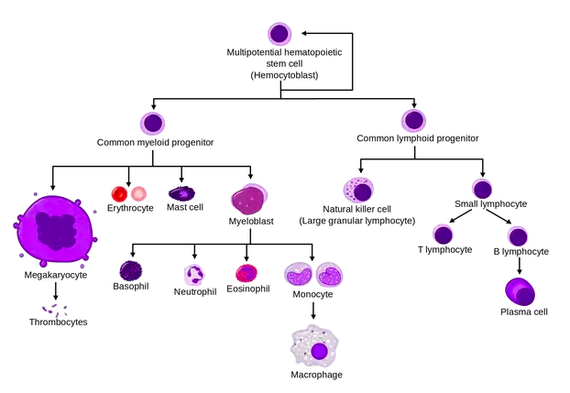
True
Everything in this diagram is type of leukocyte
Non-specific resistance to infection
Specific Resistance to infection

Slide 5
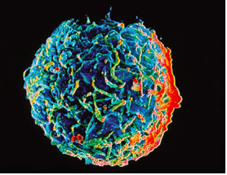
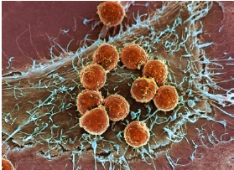
Specific Resistance to Infection
Humoral
or
Antibody-mediated response
Cell-mediated response
B Cells
These lymphocytes are produced in the bone marrow
T Cells
Mature in the bone marrow
Mature in the thymus gland
Both of these cells are found in lymphoid tissue
(lymph nodes, spleen, thymus gland, tonsils)

Slide 6
Antibody mediated immunity
Antigens
Any substance capable of causing a specific immune response
Usually proteins on surface of cells, viruses, fungi, or bacteria
Toxins, chemicals, drugs, foreign particles (splinter)

Slide 7
Antibody-mediated immunity
Self-antigens
Large molecules produced in a person’s own body do not cause an immune response
Non-self antigens
Compounds that trigger an immune response

Slide 8
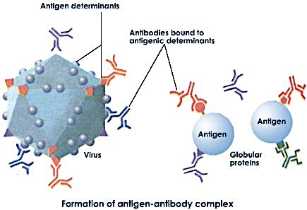
Antibody-mediated immunity
Antibody
Y-shaped protein produced in response to a non-self antigen
Belong to a group of proteins called immunoglobulins (Ig)
Antibodies can bind specifically to active sites on its corresponding antigen (antigen-antibody complex)

Slide 9
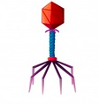
Non-self/foreign antigen reaches lymphoid tissue and activate B-lymphocytes

Slide 10
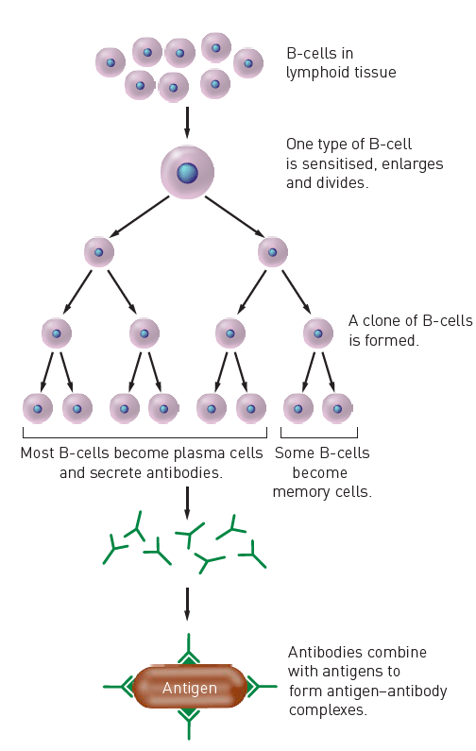
Antibody-mediated immunity
B-cells are sensitized
Enlarge and divide into a group of cells called clones
Most of clones become antibody-secreting plasma cells, the rest become memory cells
Antibodies circulate in the blood, lymph and extracellular fluid
Memory cells spread to all body tissues, so that a rapid response can occur should the antigen enter the body again

Slide 11
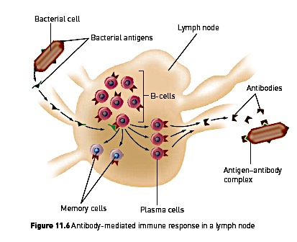

Slide 12
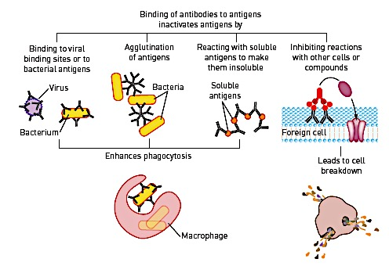
How do antibodies work?
*Before bacteria, toxins and viruses enter the body’s cell; also red blood cells from a different blood group that the person

Slide 13
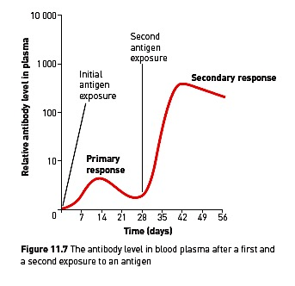
Primary vs. Secondary Response
Primary response
First exposure to an antigen
Slow response
B-cells to multiply and differentiate into plasma cells
Taking several days to build up large amounts of antibodies
What allows this rapid response to occur?

Slide 14
Apply your knowledge
Why do people tend to get fewer colds as they get older?

Slide 15
Why do people tend to get fewer colds as they get older?
Each time they are exposed to a disease, their immune system will activate a certain number of B-cells
These cells will multiply and some will produce antibodies.
Others will become memory cells. Memory cells can last for decades in a person’s body and are able to produce the necessary antibody when exposure to the micro-organism occurs again.
Each time a person gets a cold they will become immune to the particular strain of the virus that causes the cold.
With age, a person will have a greater variety of memory cells and be in a better position to ward off infection.

Slide 16
Apply your knowledge
Typhoid is caused by a bacillus. To make a positive diagnosis of typhoid a sample of the patients blood is taken and mixed with typhoid bacilli. If the bacilli agglutinate (clump together), the patient has typhoid.
Why is this a positive diagnosis for the disease?
Could the person be suffering from some other disease?

Slide 17
Cell-mediated immunity
Provides resistance to the intracellular phase of bacterial and viral infections
(i.e. once the pathogen has infected cells)
Legionnaire’s disease
Bacterial infection
Taken up by macrophages - where they successfully multiply and destroy the macrophage
Bacteria is released, to infect more macrophages

Slide 18
Cell-mediated immunity
Involved in:
Providing resistance to fungi and parasites
Rejection of transplanted tissue
Cancer cells

Slide 19
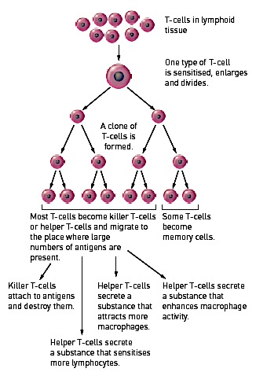
Cell-mediated immunity
T-cell presented with the antigen
T-cell can now be programmed for that particular antigen, and thus, sensitised

Slide 20
Cell-mediated immunity
Killer T-cells
  Migrate to site of infection
  Attach to invading cells & secrete substance that will destroy the antigen
Helper T-cells
  Secrete a number of substances
    Sensitise lymphocytes at site of infection = intensify immune response
    Attract macrophages
    ↑ phagocytic activity of macrophages
Suppressor T-cells
  Slows down immune response after infection is dealt with successfully
  Release substances that inhibit T- and B-cell activity

Slide 21
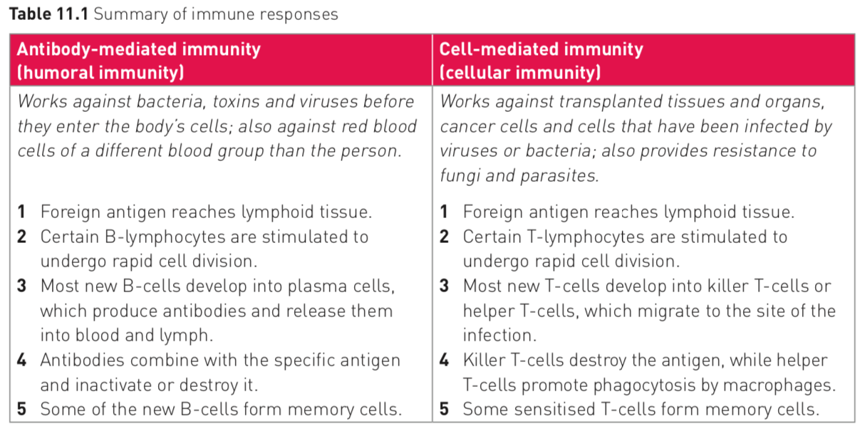

Slide 22
Relate these pictures to content you we have just covered!

Slide 23
Immune system Part 2: Crash course
https://www.youtube.com/watch?v=2DFN4IBZ3rI

